Slide 1
GROUP 27
PROGECT: DESIGN A 16-BIT MICROPROCESSOR

Slide 2
NAMES OF GROUP MEMBERS : MATRICULE NUMBER
NTUI RAOUL NTUI NJOCK ……………………………………………………… FE21A288
KAMCHE YANN ARNAUD ………………………………………………………….FE21A208
CHO WESLY MUNGO ……………………………………………………………… FE21A160
KOUOTOU AHMAD BILAL ………………………………………………………..FE21A221
JULIE ENANGA NJOMBE……………………………………………........... FE21A371
AHOUMO TEMATEU ROXANE PHILIPINE……………………………..... FE21A128
DJIALEU TANKOUA KEANE RANY…………………………………………….FE21A170
NJOMBA ROSINE DZELAMONYUY………………………………………….. FE21A396
DJUIKO METSANOU MERIEM TRESOR……………………………………..FE21A355

Slide 3
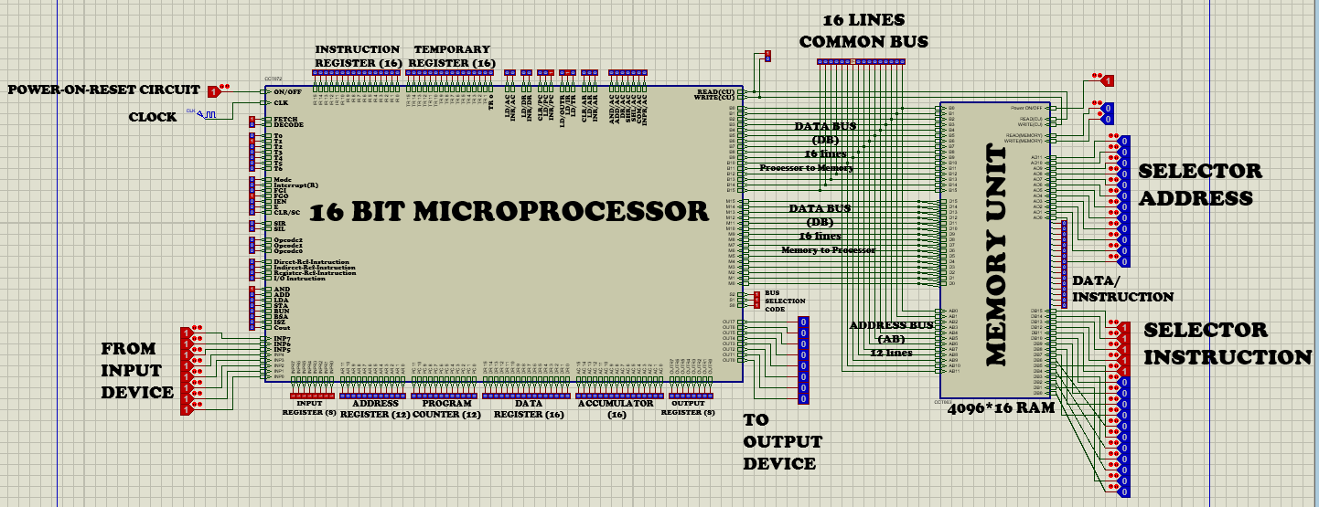
THE MICROPROCESSOR The microprocessor compose of the control unit , bus, memory, registers, adder and logic circuit.

Slide 4
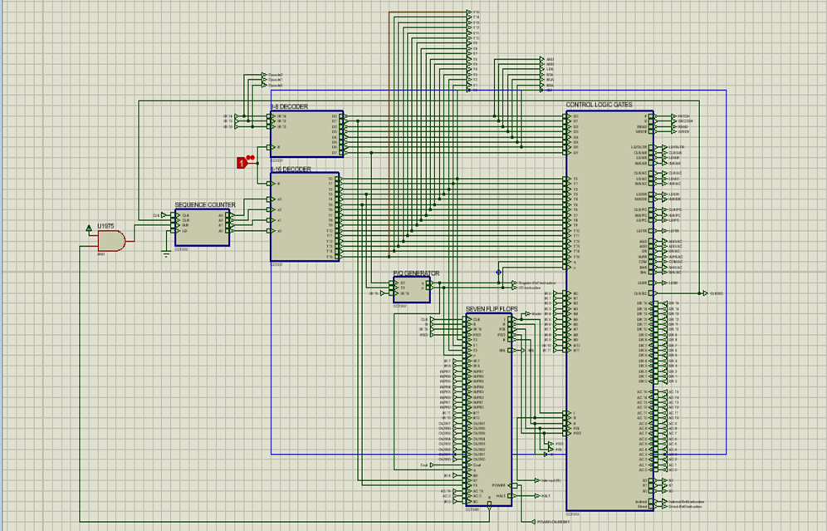
THE CONTROL UNIT
Control unit interprets instructions, regulate and control processor timing. Directs data flow through different components of the CPU. It handle tasks such as decoding, fletching, executing the command and storing results. It Sends and receives control signals from other computer components.

Slide 5
REGISTERS
Register is one of a small set of data holding places that are part of the computer processor, it may hold an instruction, a storage address, or any kind of data. It comprises of flipflops with each flipflop capable of storing information
There are 9-registers which are;
The address register
The data register
The instruction register
The accumulator
The temporary register
The program counter
The input register
The output register
The sequence counter
The three important functions of registers are fetching, decoding, and execution.

Slide 6
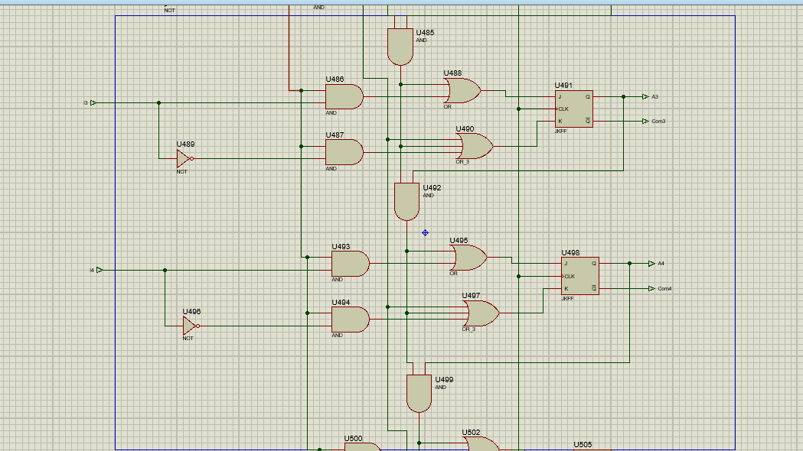
THE CIRCUITRY DIAGRAM OF A REGISTER

Slide 7
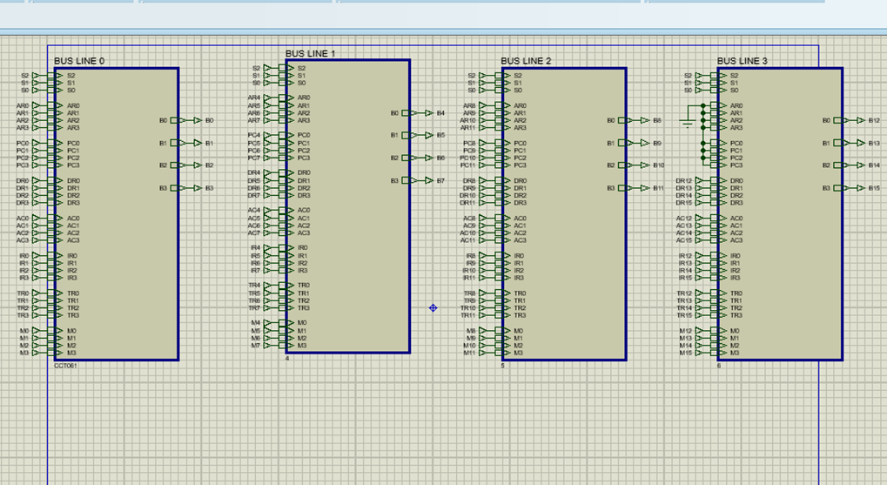
THE BUS A system bus refers to a single computer bus that connects the major components of a computer system, combining the functions of a data bus to carry information, an address bus to determine where it should be sent or read from and a control bus to determine its operation. The main function to transfer data from one component of the microprocessor to another, it can be seen in the figure below. There are 4-bus lines with each of them having four 8x1-MUX.

Slide 8
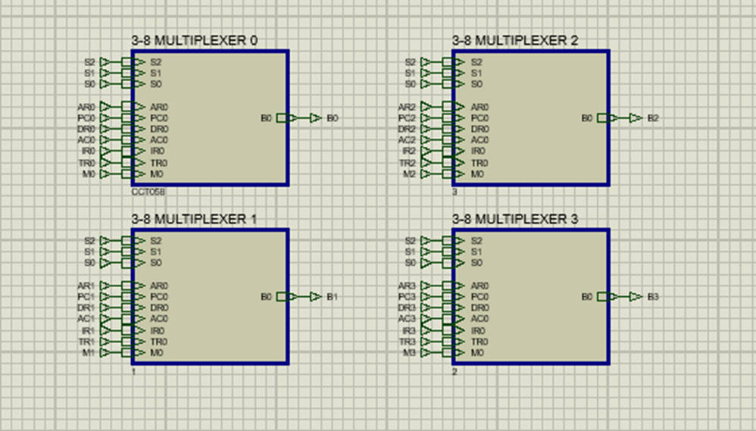
INSIDE ONE BUS LINE As you can observe, we have four 8x1-MUX.

Slide 9
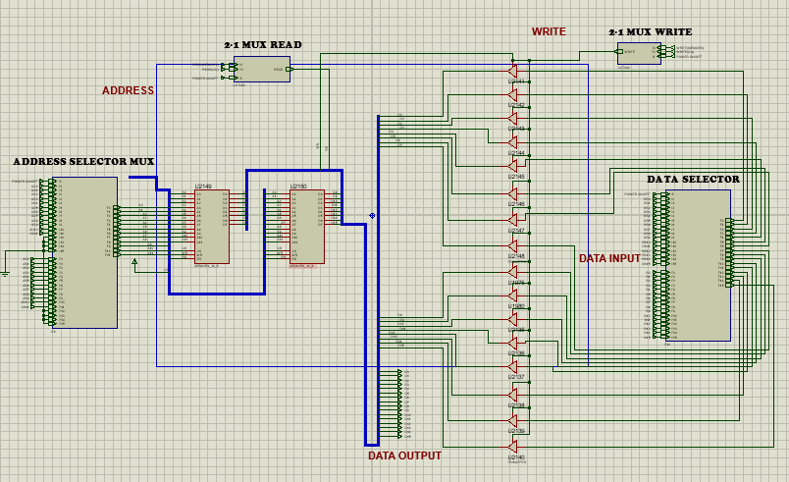
MEMORY
Memory is a system or process that stores what we learn for future use. Our memory has three basic functions that is encoding, storing, and retrieving information.it stores all the data and the instructions required for processing.

Slide 10
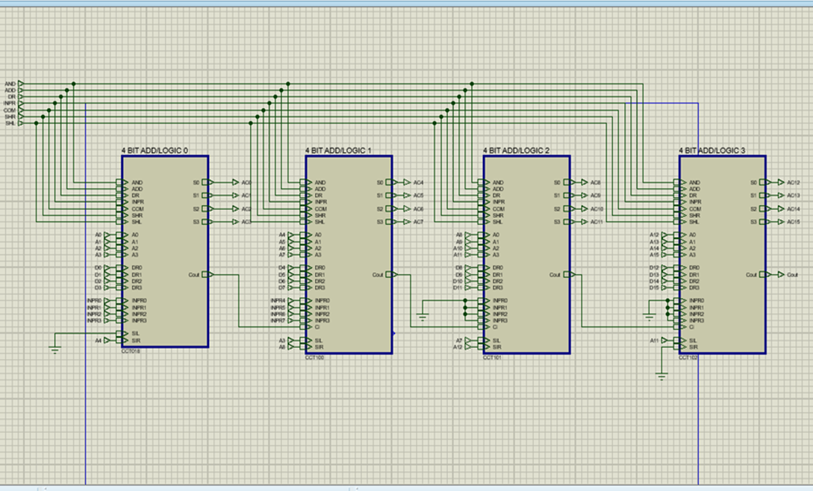
THE ADDER AND LOGIC CIRCUIT
An adder is a digital logic circuit in electronics that implements additions, subtractions, of numbers. In many computers and other typed of processors, adders are used to calculate addresses, similar operations.

